Slide 1
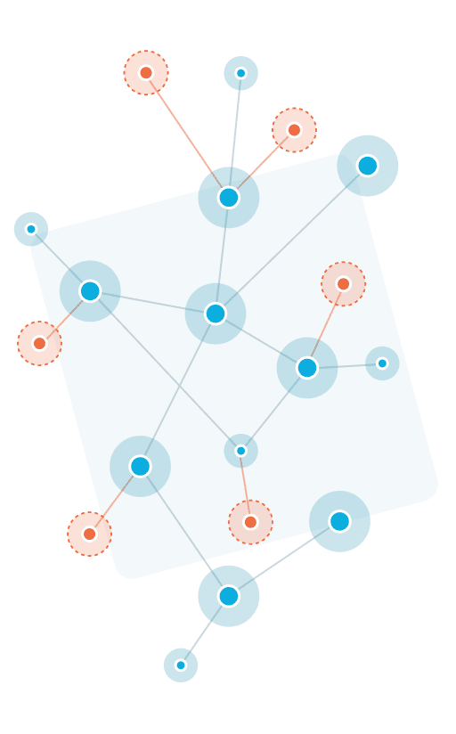
Clique Problem Problem id: 9
Submitted to
Redwan Ahmed Rizvee
Department of Computer Science and Engineering ,
East West University
Submitted By
Fahad Ahamed :2020-2-60-174
Navid Zaman : 2020-2-60-044
Md Tahsin : 2020-2-60-112

Slide 2
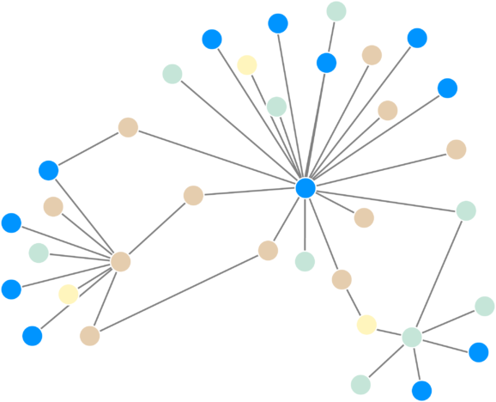
Topics
Introduction
Objective
Approaching the problem
Implementation
Complexity Analysis
Real life application
Conclusion

Slide 3
Introduction
What is clique?
A subset of a graph which basically form a complete graph is called a clique
Nodes : 1 - 2 - 3
1
1
2
3
2
3
Cliques of size 3 :
Nodes : 2 - 3 - 4
2
3
4
4

Slide 4

Objective
We have to find out the number of cliques of a given size from a graph !

Slide 5
Our Approach to solve the problem !
Assuming each nodes as a part of clique
Checking if added nodes form a clique of given size or not
If yes ! Then store the cliques.
Finding degree of each nodes
Step 2
Step 3
Step 4
Step 1

Slide 6
Algorithm Discussions
Clique(int start, int value, int clique_size){
FOR i = start to limit
IF degree of i >= clique_size-1
FOR j=1 to value+1
FOR j+1 to value+1
Check connection
END IF
IF connected_node= true
IF value = clique_size
store to store_clique
End IF
End IF
IF value < clique_size
Clique( i, value+1, clique_size)
End IF
End IF
End FOR
}
Key Notes-
1. 3 parameters-start node, initial clq size, k
2.Limit initialize, how many nodes to check
3.Then for loop, check condition degrees>=clq size
4.If yes then store it and complete confirm

Slide 7
Complexity Analysis
Clique(int start, int value, int clique_size){
FOR i = start to limit
IF degree of i >= clique_size-1
FOR j=1 to value+1
FOR j+1 to value+1
Check connection
END IF
IF connected_node= true
IF value = clique_size
store to store_clique
End IF
End IF
IF value < clique_size
Clique( i, value+1, clique_size)
End IF
End IF
End FOR
}
O(V)
Overall Time complexity O(k² * V^{k}).
O(K²⁾
Overall Space complexity O(V² *K )
O(K)

Slide 8
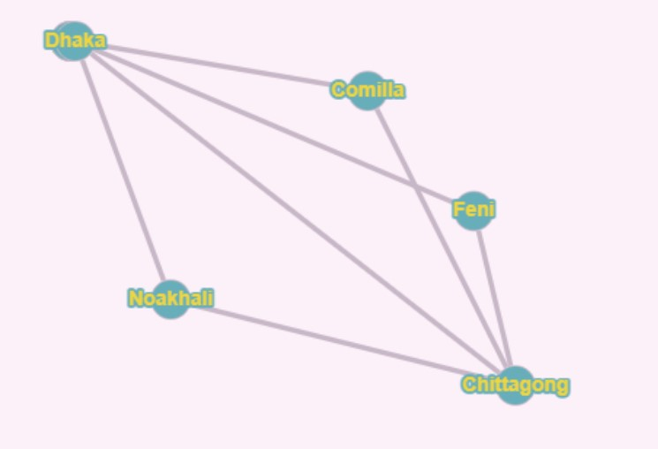
Real life Application Scenario
“Tour guide Application based on Clique Algorithm “
Nodes represent Cities
Edges represent routes through where we provide services (Bus and Hotel )
User inputs Current city and Destination city
Our application suggests Routes through where user can reach the destination
Application provides bus and hotel service as packages

Slide 9
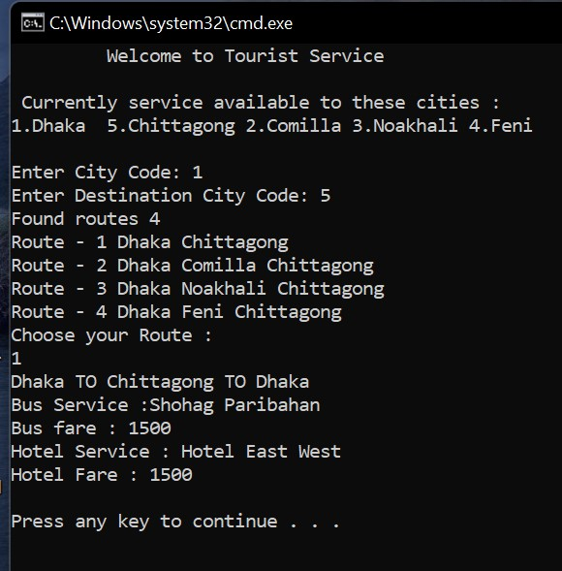
Tourist Service Application
Clique of Size 2 :
Dhaka – Chittagong
Clique of Size 3:
Dhaka – Comilla – Chittagong
Dhaka –Noakhali – Chittagong
Dhaka – Feni _ chittagong
User inputs city Codes
App outputs no of routes (Clique paths)
User chooses route
App Shows packages

Slide 10

Real Time Application
One of the common implementations of a clique is a social network where the vertices of the clique graph represents people and the edges of that graph of that clique graph represent mutual relation among them. The clique graph represents a group of mutual friends where all of them know each other.

Slide 11
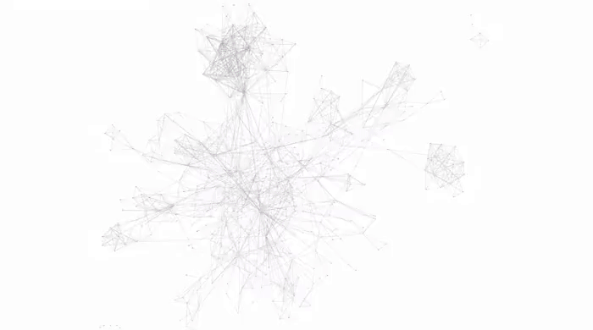
Conclusion
Thank You

